Slide 1









Customer Retention
Submitted by : Manali Raj

Slide 2
Introduction
Customer satisfaction has emerged as one of the most important factors that guarantee the success of online store
Exhaustive analysis has been performed to obtain the model to for the rendition of the customer and customer activation
Key factors that brings success is quality in system and their service along with trust and benefit to customers and organisation as well .

Slide 3
Current challenge and Solution
Devise the model through the existing data set to retain the customer and
To understand the behaviour of the customers to understand the purchase/shopping intention

Slide 4
Steps for Data Analysis
Validate shape of data
Find data types
Null values Identification
Checking description
Displaying values in terms of percentage.
Perform Count plot
Bivariate

Slide 5

Key Graphs

Slide 6
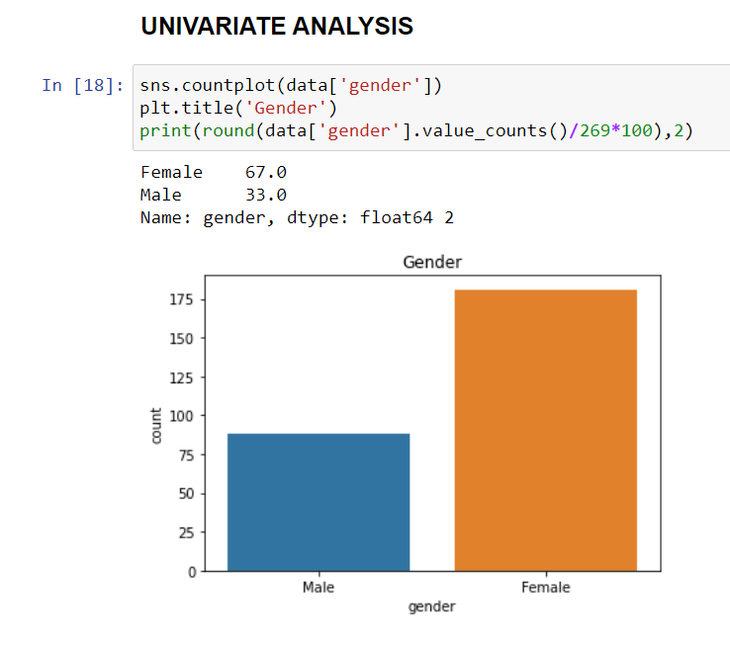
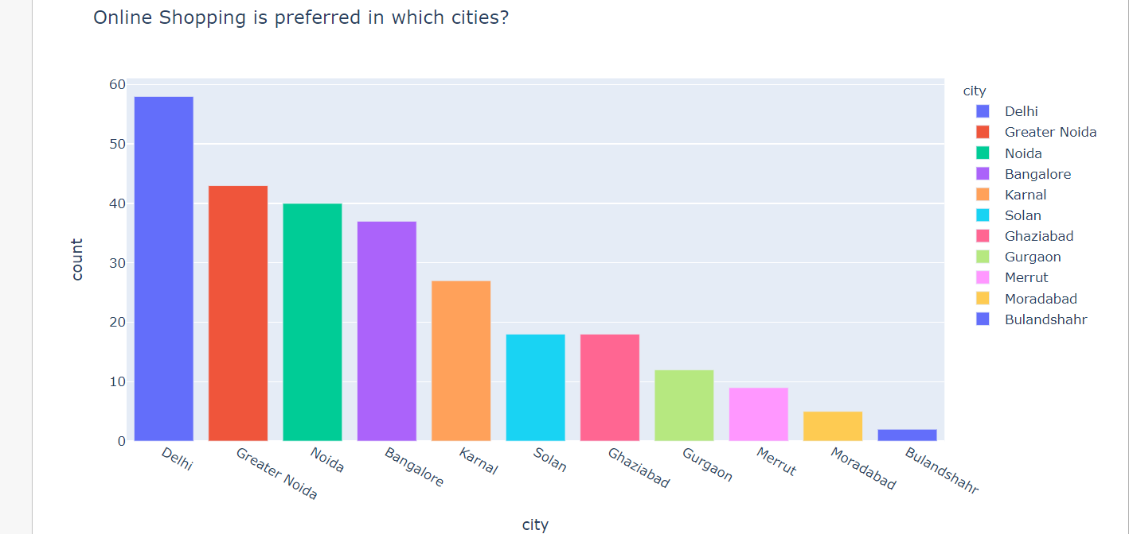
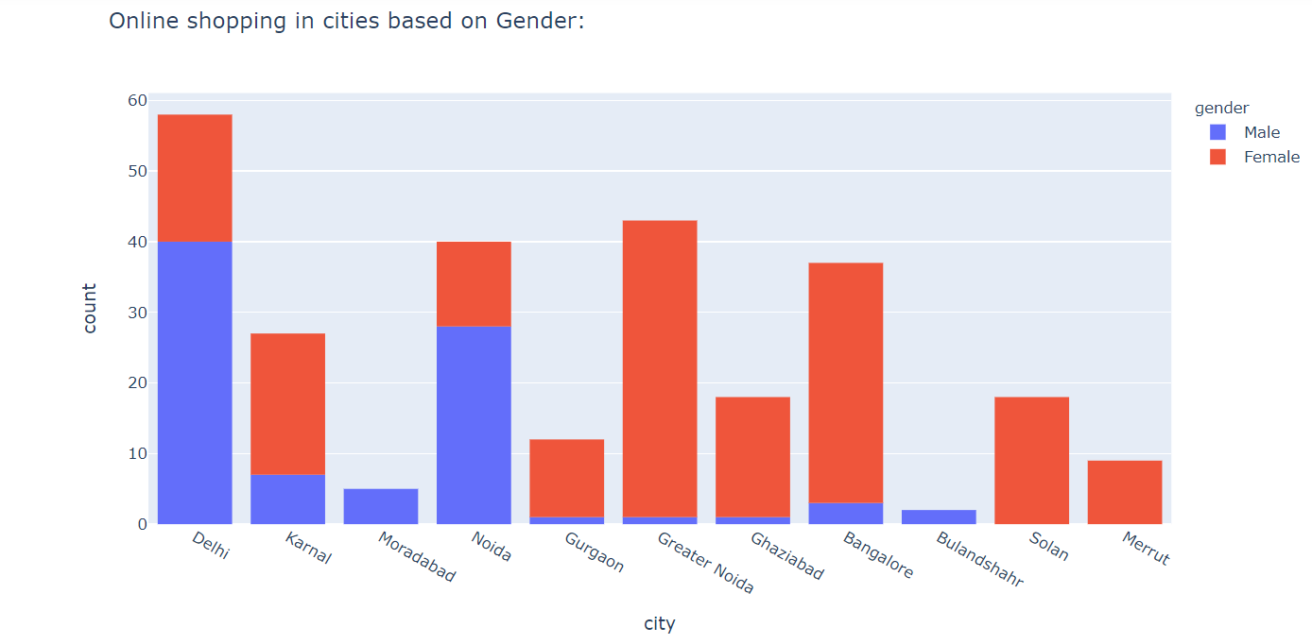
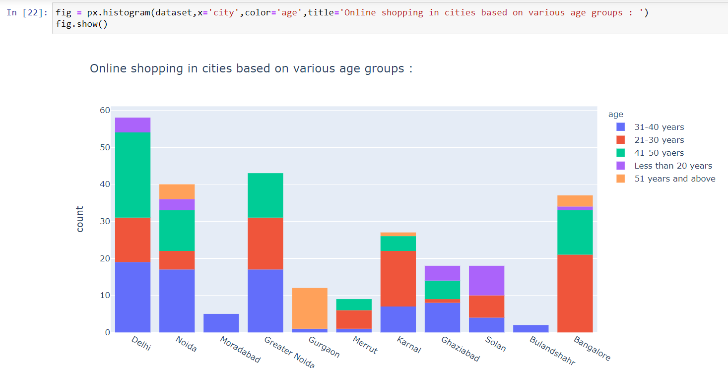
Graph Visualization

Slide 7
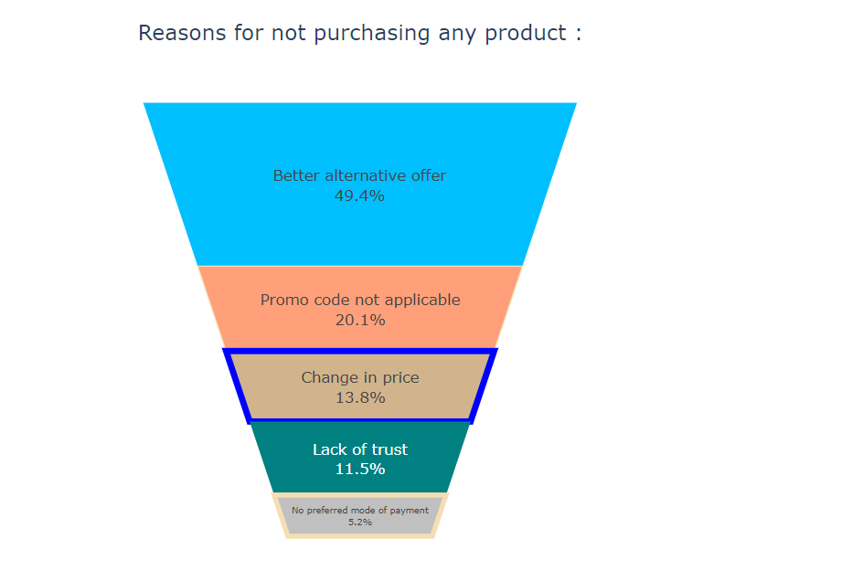
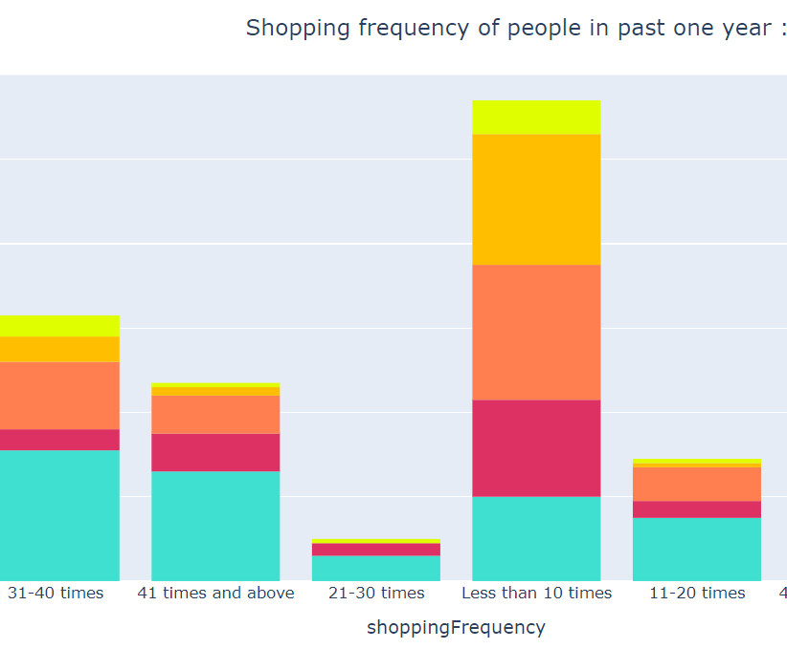

Slide 8
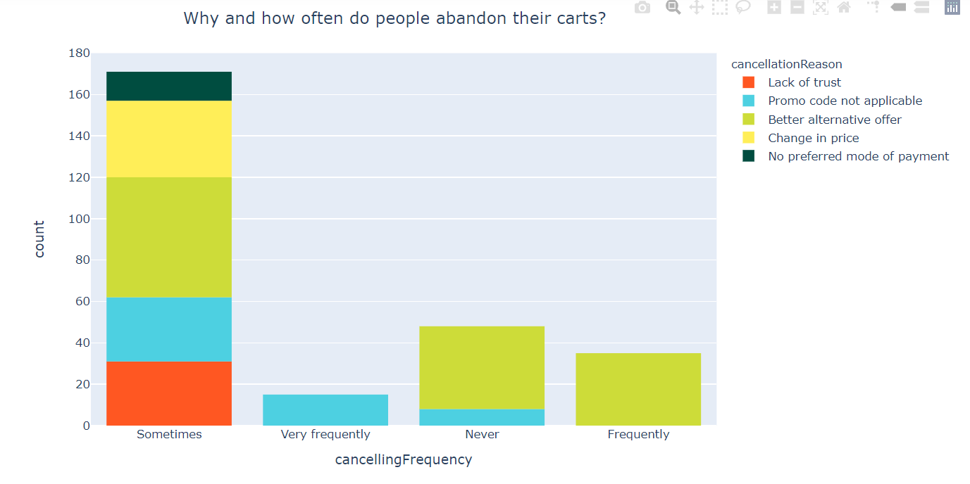
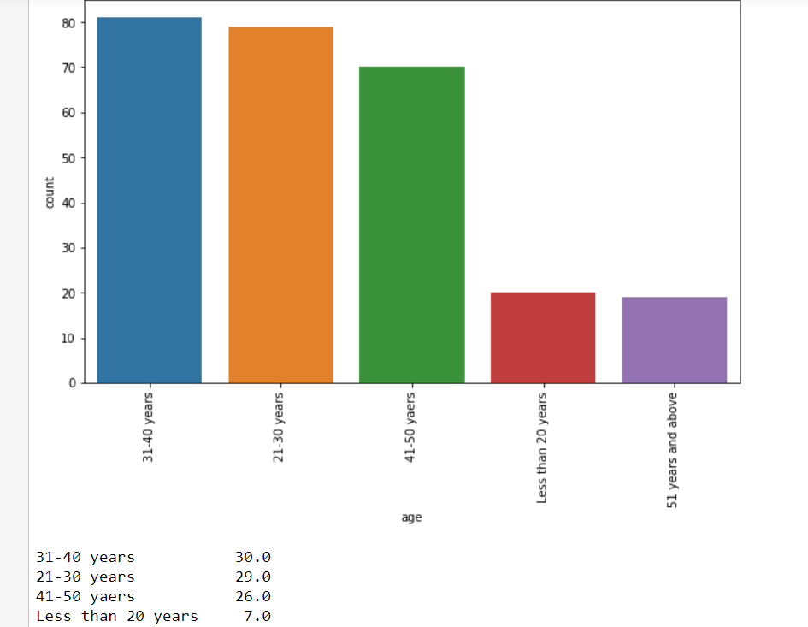
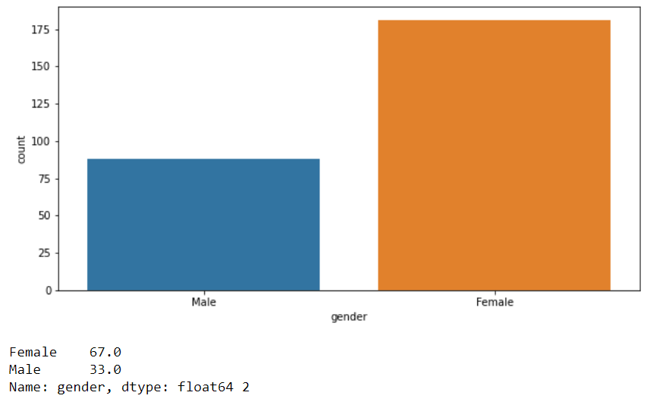
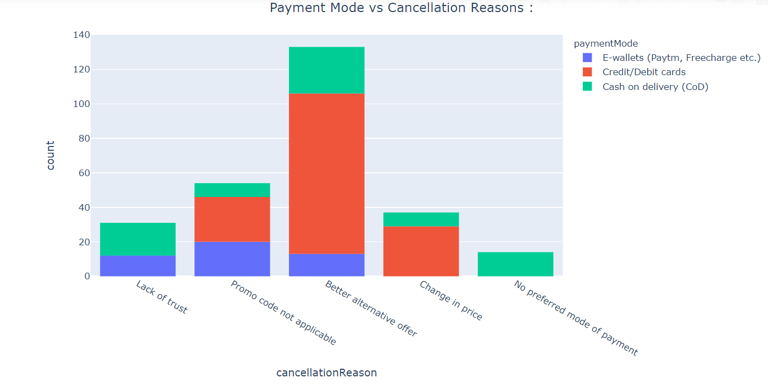

Slide 9
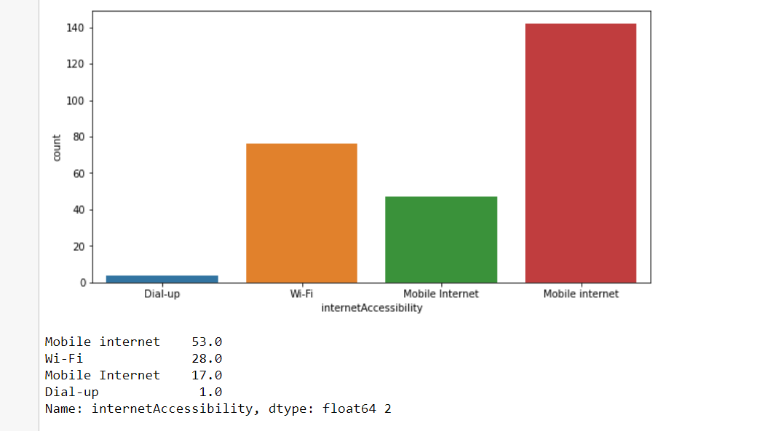
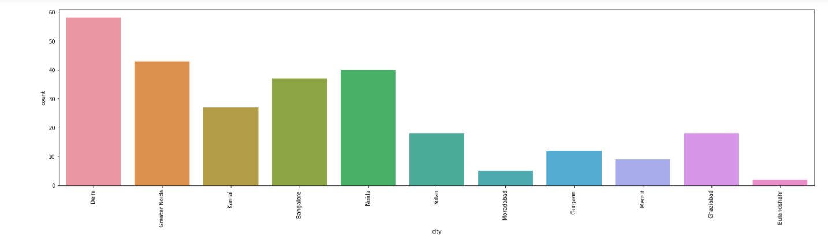
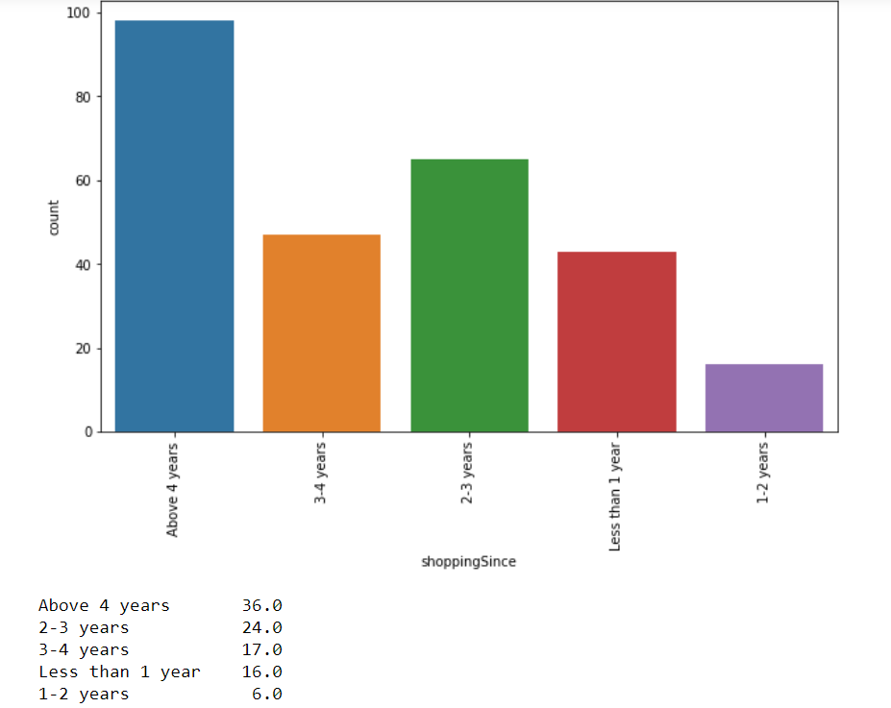
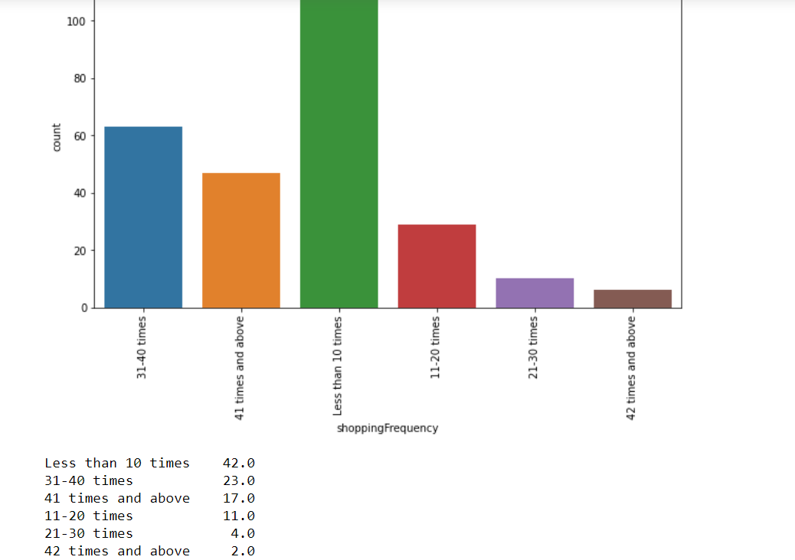

Slide 10

Analysis

Slide 11

Analysis
Female customers are more than male customers
Online shopping is more in trend
Metro Cities have high number of sales

Slide 12
Analysis
70% customers used mobile internet for online purchase
52% customers used Smartphone for online purchase, 32% used laptop least 4% used tablet
45% customers use Windows phone
80% customers used Google chrome for online purchase
86% customers uses Search engine to reach their favourite online store

Slide 13

Analysis
85% customers were happy with website
87% customers agree with accessibility of the website
Positive feedback on various option for the payment
~ 70 of customers expect the data privacy
Multiple communication channels are required to interact as per the customer
Online shopping is preferred more due to discounts and other rewards
50 % of customers have shown interest in loyalty program

Slide 14
Analysis
48% customers like flipkart, amazon shows wide variety of products
37% customers prefers flipkart and amazon because of relevant information
78% customers trust Amazon to be reliable , 55% likes flipkart , 25% Myntra
80% customers likes Amazon's quickness to complete the purchase , 60% likes Flipart's, 30% likes Myntra's
86% likes Amazon's delivery speed , 56% likes Flipkart's , 5% likes Myntra’s
82% customers trust amazon in terms of keeping the privacy of their data, 56% trust flipkart 20% trust Myntra , 12 % trust Snapdeal
84% customers believe Amazon perceived trustworthiness, 43% - Flipkart , 33% - Myntra ,Snapdeal 27% Snapdeal
86% customers like Amazon in terms of online assistance through multi-channel , 51% -Flipkart ,42% Myntra

Slide 15

Conclusion

Slide 16
Conclusion
Friendly Navigation
Easy accessibility
Return and Refund Policy
Privacy Policy
Quality Information
Communication Channels
Feedback

Slide 17
Thank you

